Slide 1


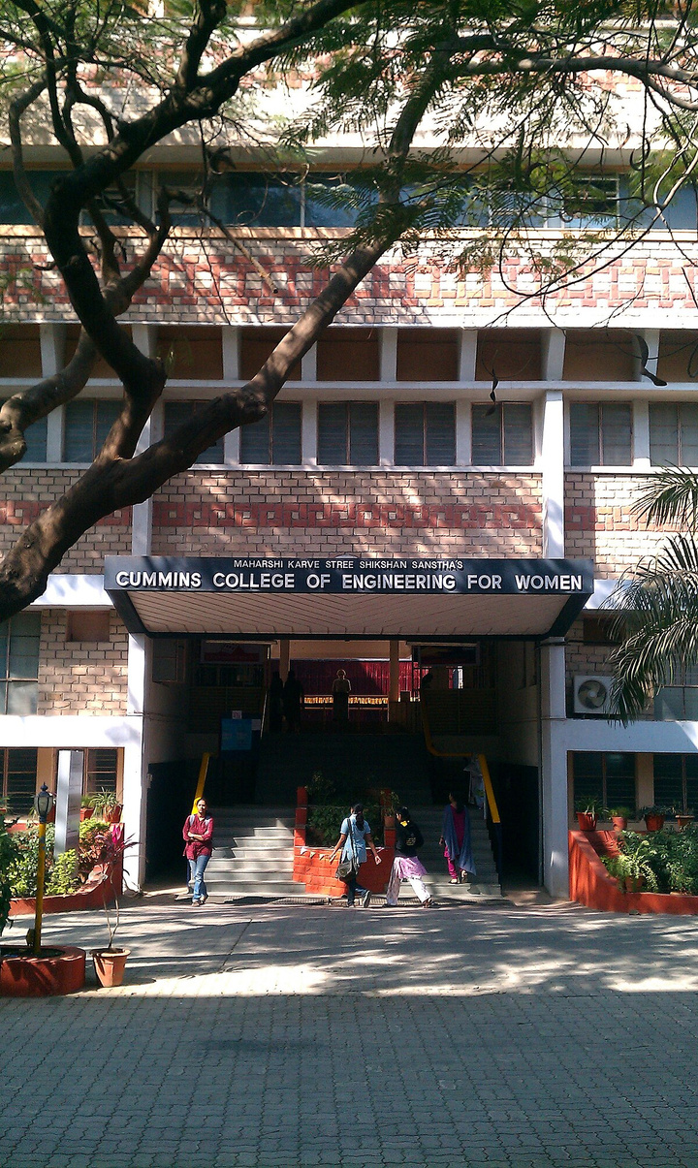

Btech six months inhouse project
MENTOR
MANAGEMENT
SYSTEM
Under the guidance of : Dr. Nitin Palan
Presented By :
Shreya Jadhav C22020111250
Prachee Sutar C22020111254
Vaishnavi Dardare C22020111265
Swati Dhanade C22020771815

Slide 2
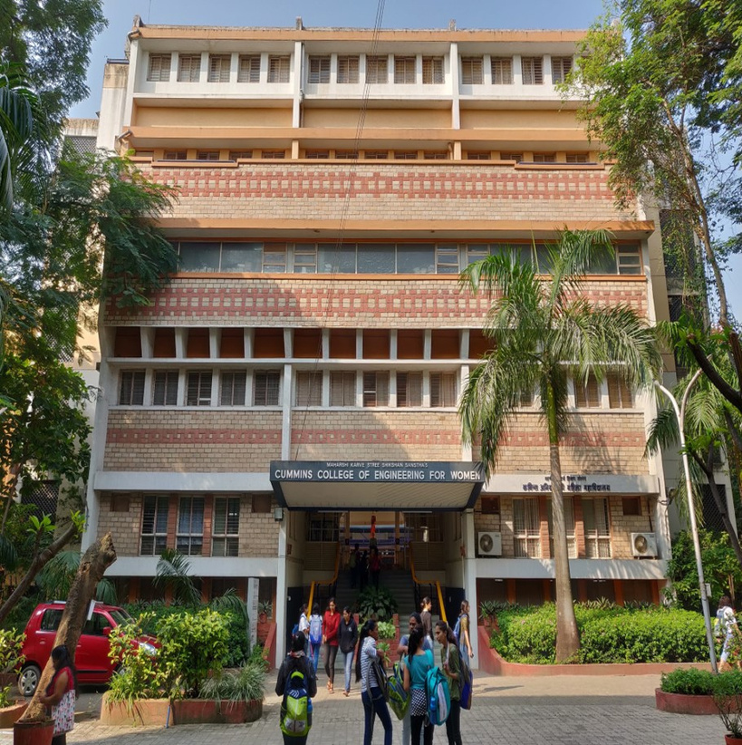
Content
01
Problem Statement
02
Introduction
03
Literature Survey
04
Objectives
05
Technology
06
Data Flow
07
Specifications
08
Centralized Database(LAN)
09
Result
10
Conclusion
11
Limitations
12
Scope of Project
13
References

Slide 3



Problem Statement
Effective mentorship plays a crucial role in shaping students' academic journey and personal growth
Aim to enhance the process through the implementation of an Online Student Mentor Management System.
College employs a manual and fragmented approach to mentor-student interactions, leading to miscommunication, missed opportunities, and a lack of comprehensive tracking.
Addressing challenges to develop a centralized digital platform that facilitates seamless communication, efficient scheduling, and comprehensive monitoring of student's activities.

Slide 4

INTRODUCTION
System is developed using JSP and Servlet technologies.
Aims to replace the conventional manual mentor management systems, Unlike traditional methods, our Mentor Management System offers real-time monitoring of mentorship activities.
Mentors can track mentee progress, provide timely feedback, and address challenges promptly.
System safeguards sensitive information, fostering trust and compliance with data protection regulations.
This shift toward a cost-effective digital solution can significantly reduce paperwork, administrative burden, and associated costs.

Slide 5

Literature Survey
Feature
Existing Mentor System
Proposed Mentor System
Efficiency
Manual tracking and communication lead to delays and inefficiencies.
Automated processes providing real-time tracking and communication.
User Interface
Often lacks a user-friendly interface, leading to a steep learning curve.
Intuitive and interactive user interface for easy navigation and engagement.
Data Security
Vulnerable to data breaches and lacks robust security measures.
Prioritizes data security and integrity, implementing measures to protect sensitive information.
Scalability
Limited scalability; struggles to accommodate a growing number of users.
Built on JSP and Servlet technologies, ensuring scalability for evolving needs.

Slide 6
Objectives
To enhance teacher-student Communication.
To keep eye on students academic and non-academic performance that includes achievements, club and co-curricular activities and so on.
To minimize issues faced by students mentors and admins.
To identify and understand each student and encourage advanced learners.
No time bound , swift communication during & after college hours .
.

Slide 7







Technology Stack
Backend
Frontend
Technology
Database
Build Tool
Language
Technology
Servlet
MySQL
Maven
Java
JSP

Slide 8
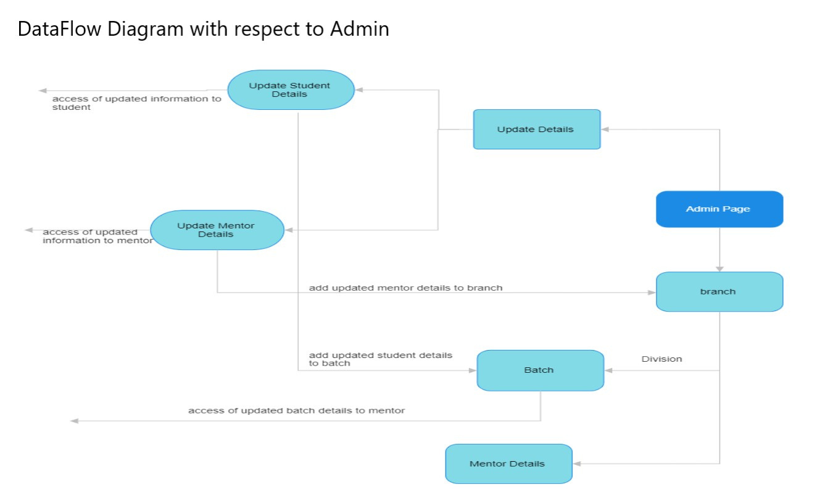
Data Flow

Slide 9
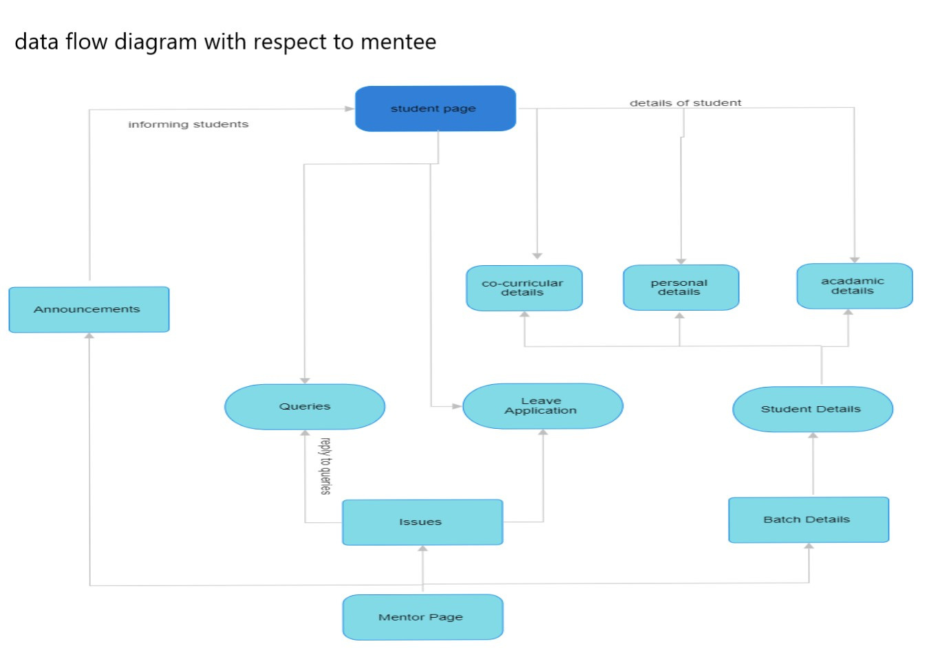

Slide 10
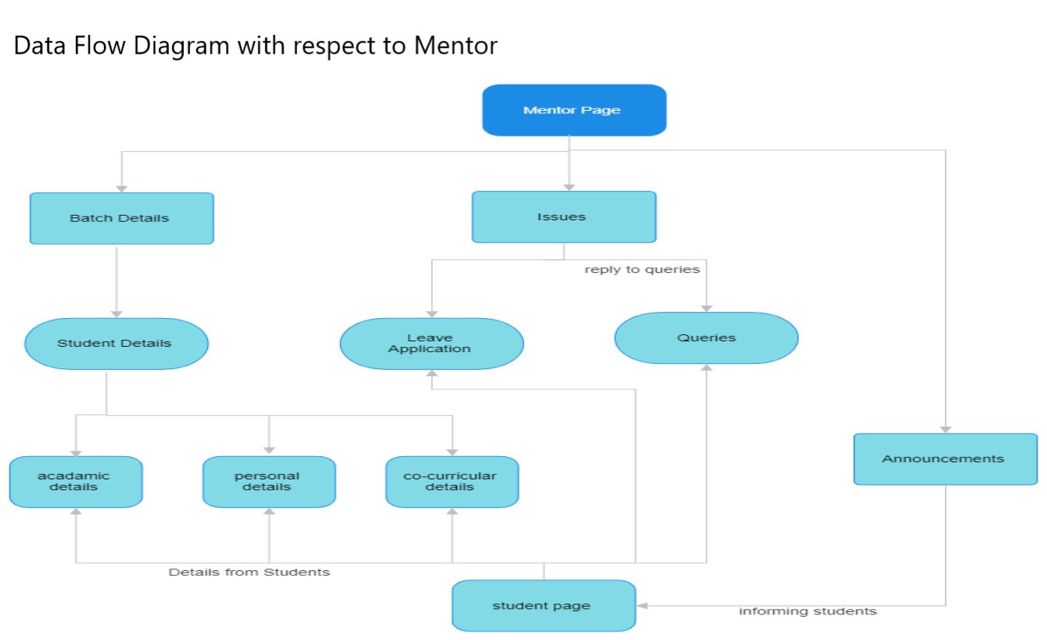

Slide 11
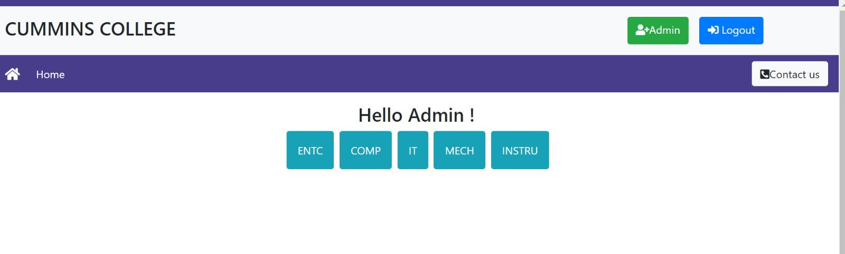
Specifications
Admin Interface
01
02
03
Register /Delete mentor/mentee View list of mentors & mentees Assign mentors to mentees

Slide 12
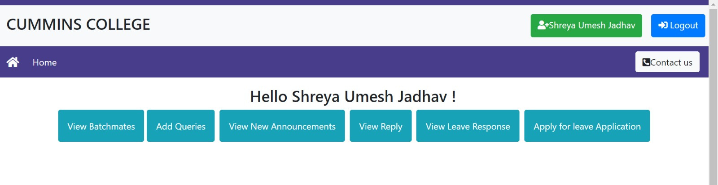
Mentor Interface
01
02
03
View Batch of Students & batch individual profile
of any student registered
under them
Viewing queries of mentees
View leave applications of mentees
04
Float announcements to batch

Slide 13
Mentee Interface
01
02
03
04
View Batchmates & Mentors View new announcements Add queries View Reply
05
06
07
View leave response Apply for leave application View leave applications of mentees

Slide 14
Centralized Database (LAN)
MySQL database is made centralized on one of the PCs in the LAN network by configuring the MySQL workbench as a server.
Configuring JDBC connectivity string.
Accessing database from another PC from the same network.

Slide 15
Results
meticulously measured essential metrics, including system uptime, response time, and user engagement levels
gained insights into user engagement patterns, system responsiveness, and the efficiency of Admin-related tasks.
designed tests mimicking real-life situations like scenarios varied in user numbers and tasks to evaluate how our system performed under diverse conditions.
scrutinized its ability to facilitate smooth communication between mentors and students while emphasizing its speed and responsiveness.

Slide 16
Conclusion
In today's fast-paced educational landscape. effective mentorship plays a crucial role in shaping students' academic journey and personal growth. Hence we recognize the significance of student-mentor interaction and aim to enhance the process through the implementation of a Mentor Management System.
Currently, the college employs a manual and fragmented approach to mentor-student interactions, which often leads to miscommunication, missed opportunities, and a lack of comprehensive tracking. To address these challenges, we intend to develop a centralized digital platform that facilitates seamless communication, efficient scheduling, and comprehensive monitoring of student's activities.

Slide 17




Limitations
Scalability Challenges:
Dependency on Local IT Support:
Scaling the system to accommodate a growing number of users or data might pose challenges.
The system may require adjustments or enhancements to handle increased loads efficiently.
The system's maintenance and troubleshooting may rely heavily on local IT support.
This can lead to delays in addressing issues and may require on-site assistance.

Slide 18
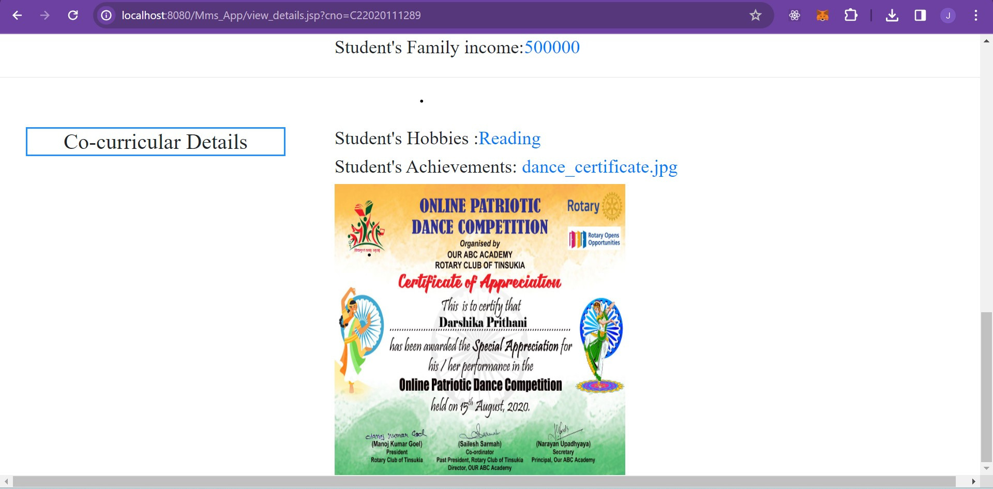

Slide 19
PROJECT SCOPE
1] Hosting of project.
2] E-mail Authentication.
3] Addition of other branches.
4] Special feature for first year students.

Slide 20
References
[1] Susamma Barua, Teachers Assistant: A Web-based Application using Java Sever Pages and Java Database Connectivity, 2000.
[2] Waltz, D.L,"An English Language Questioin Answering System for a Large Relational Database", Communication of th ACM, 21.
[3] The Apache Software Foundation. The Number One HTTP Server an the Internet .http: //httpd. apache. org/. [10] LIU Bu-xing. JSP dynamic design of garbage characters in Chinese solution [J]. Power Vocational and Technical Jour-nals, 2009
[4]Budi .K. (2015), “The Servlet API”,Servlet & JSP: A Tutorial, Second Editionthis book helped to clear the topic related to servlet API’s which supports session management

Slide 21

THANK YOU

